Slide 1
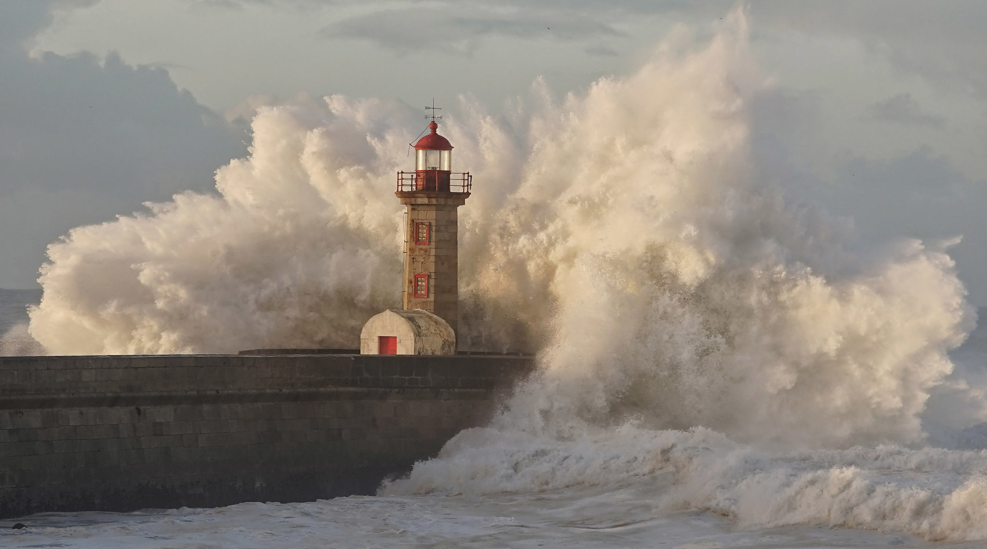


Climate risks for energy security: Findings of the first European Climate Risk Assessment
Technical Exchange Visit – Ukraine to the EEA
22 October 2025
Dr. Hans-Martin Füssel (EUCRA coordinator & Expert – Climate change risks and adaptation, EEA)
© António Tedim, Well with Nature EEA
Notes:
In my presentation, I would like to address various aspects of the first European Climate Risk Assessment, which I coordinated from 2022 to early 2024.

Slide 2
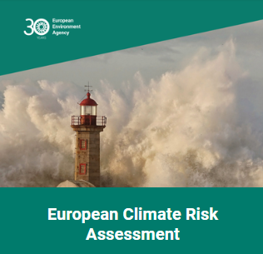
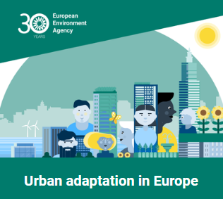
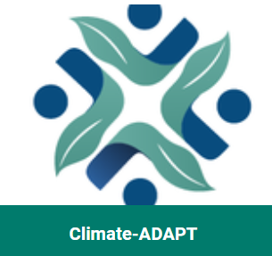
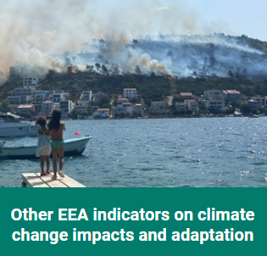
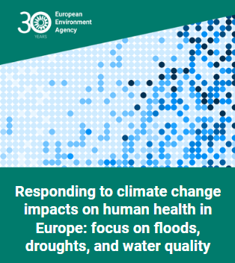
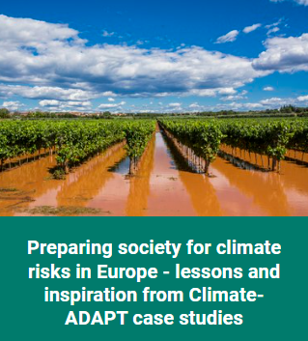
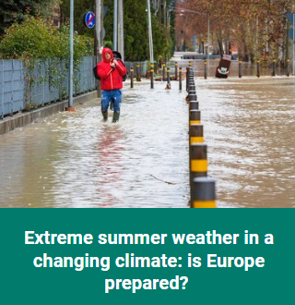
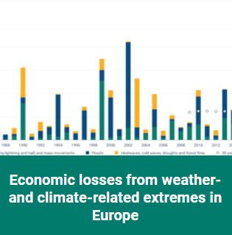
The EEA’s work on climate change adaptation
Climate change impacts, risks and adaptation
Climate-ADAPT

Slide 3
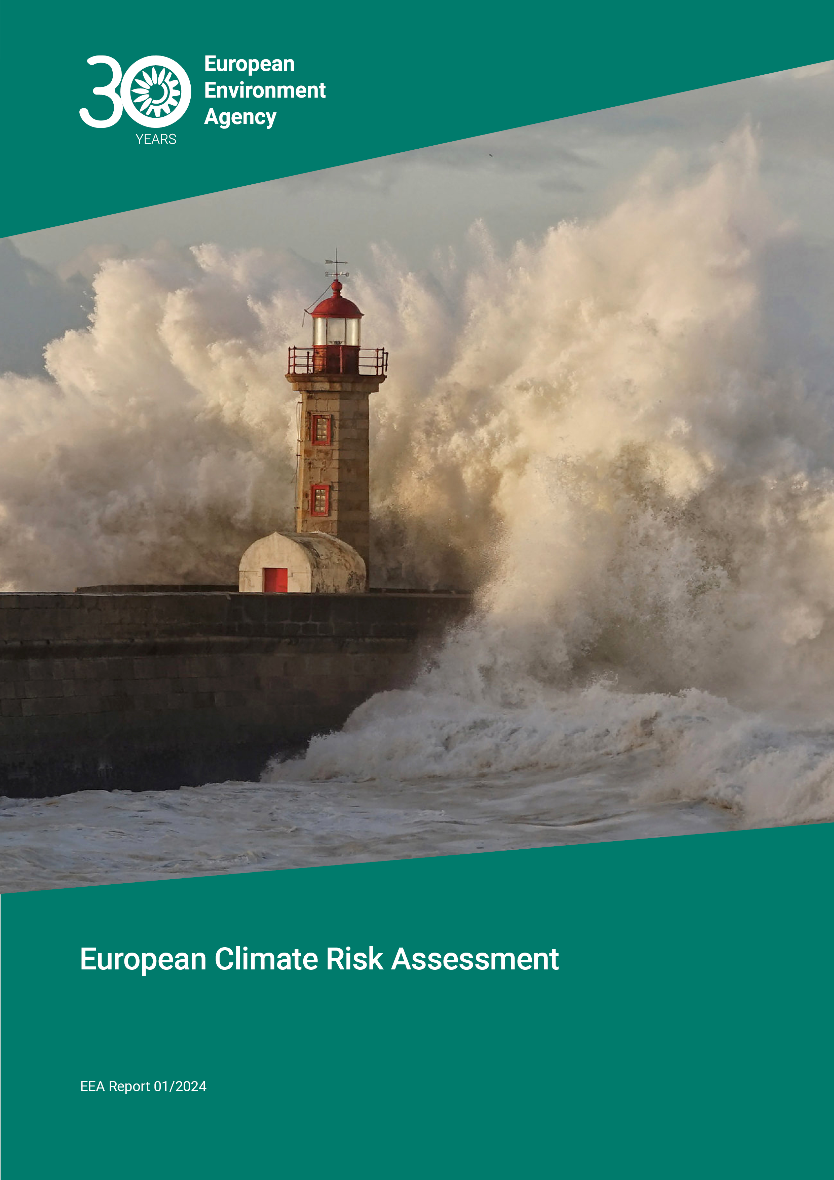
Europe is not sufficiently prepared for rapidly growing climate risks
Europe is the fastest warming continent.
Climate risks are growing rapidly as we approach 1.5 degrees global warming.
Climate change threatens our ecosystems, water resources, food and energy security, health, infrastructure, and financial stability.
Southern Europe is a hotspot region for multiple climate risks, in particular those caused by extreme heat and droughts.
Low-lying coastal regions and EU Outermost Regions are further hotspots.
eea.europa.eu/publications/european-climate-risk-assessment
Notes:
Let me start by presenting key results of EUCRA published in spring 2024
READ

Slide 4
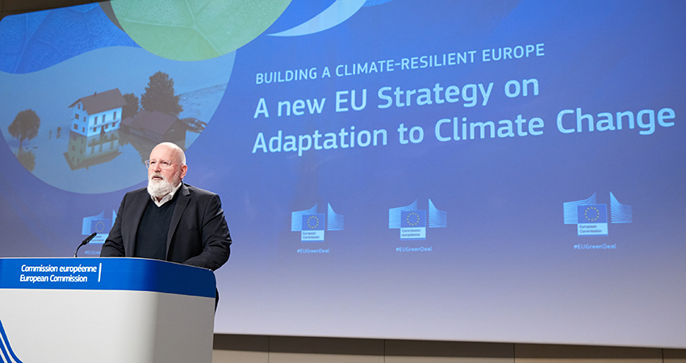
Forging a climate-resilient Europe – the new EU Strategy on Adaptation to Climate Change, 24 February 2021
Launch of a European climate and health observatory under the European Climate Adaptation Platform Climate-ADAPT.
The Commission will draw up an EU-wide climate risk assessment. This assessment will pay special attention to health threats, ecosystem vulnerabilities, critical infrastructures, TEN-E projects of common interest and TEN-T corridors and networks
Notes:
The context we live in in Europe

Slide 5
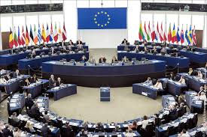
European Parliament resolution, 15 September 2022
“Calls on the Commission to urgently draw up a comprehensive EU-wide climate risk assessment paying special attention to risks of droughts, forest fires, health threats, ecosystem vulnerabilities and the effect on critical infrastructure and network hotspots in order to guide and prioritise short-, medium- and long-term adaptation and resilience efforts”
Notes:
The context we live in in Europe

Slide 6
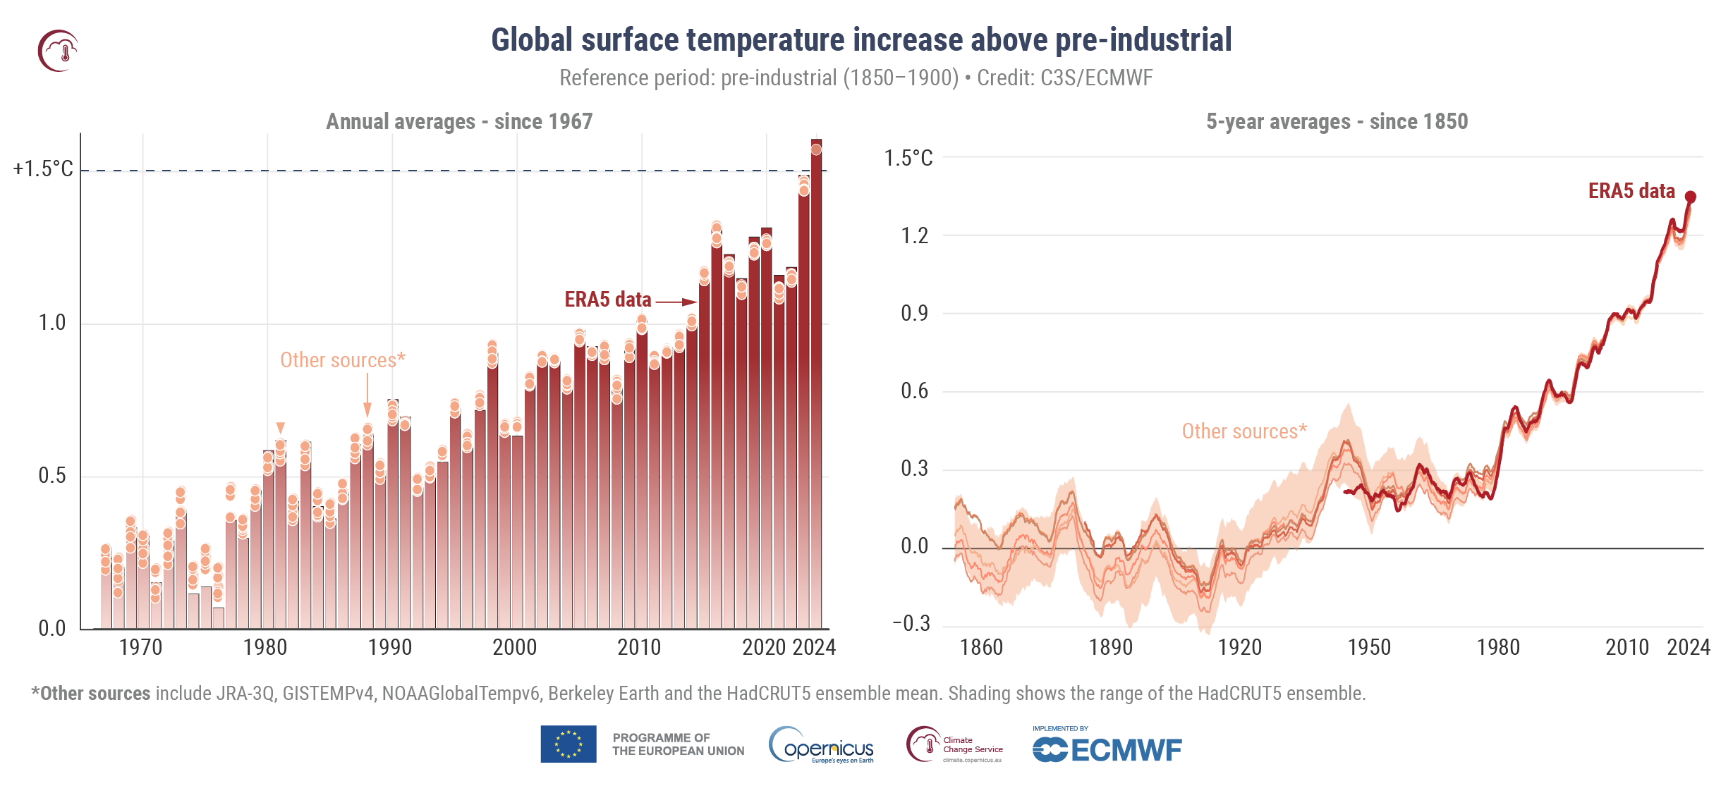
We are already living in an unprecedentedly warm world
2024 was by far the warmest year on record globally, followed by 2023
Both years were likely the warmest years during the last 120 000 years, and possibly the last 3 million years.
The summer 2024 was the warmest summer globally and in Europe
Notes:
Climate change is the new reality

Slide 7
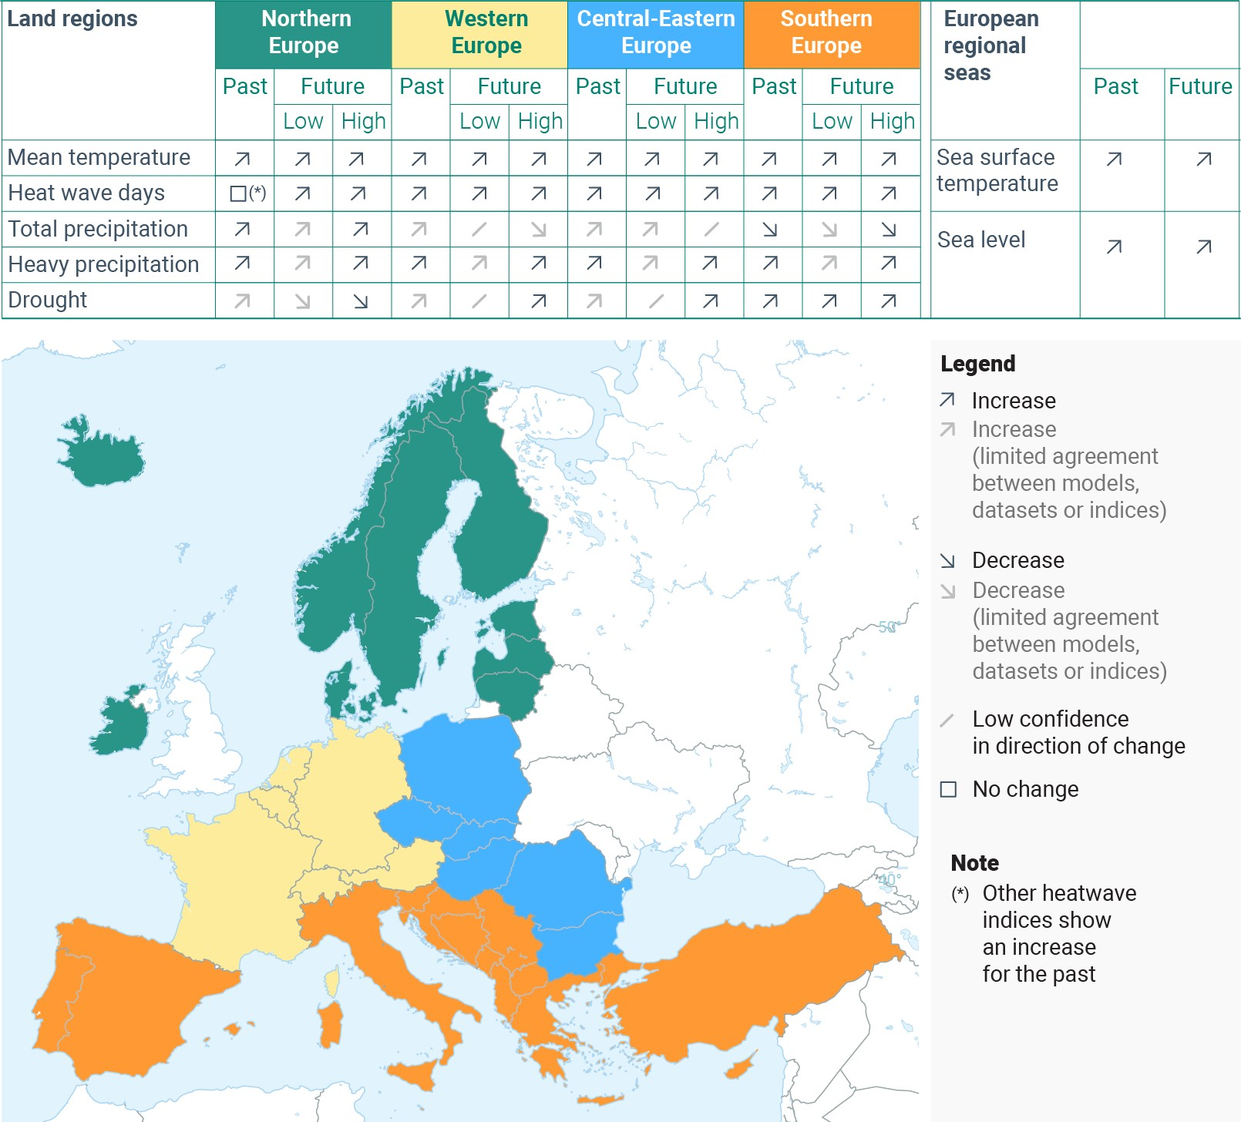
Climatic risk drivers are accelerating in all regions
Heatwaves are getting worse.
Rain patterns are changing, with both downpours and dry spells increasing in magnitude.
Sea level rise is accelerating and threatening coastal regions.
Hotspot regions for multiple climate risks:
Southern Europe
Low-lying coastal regions
EU outermost regions
Notes:
This slide shows changes in key climate risk drivers for four European macro-regions
Note that EEA’s Europe extends beyond the EU – from Iceland to Turkiye
READ

Slide 8
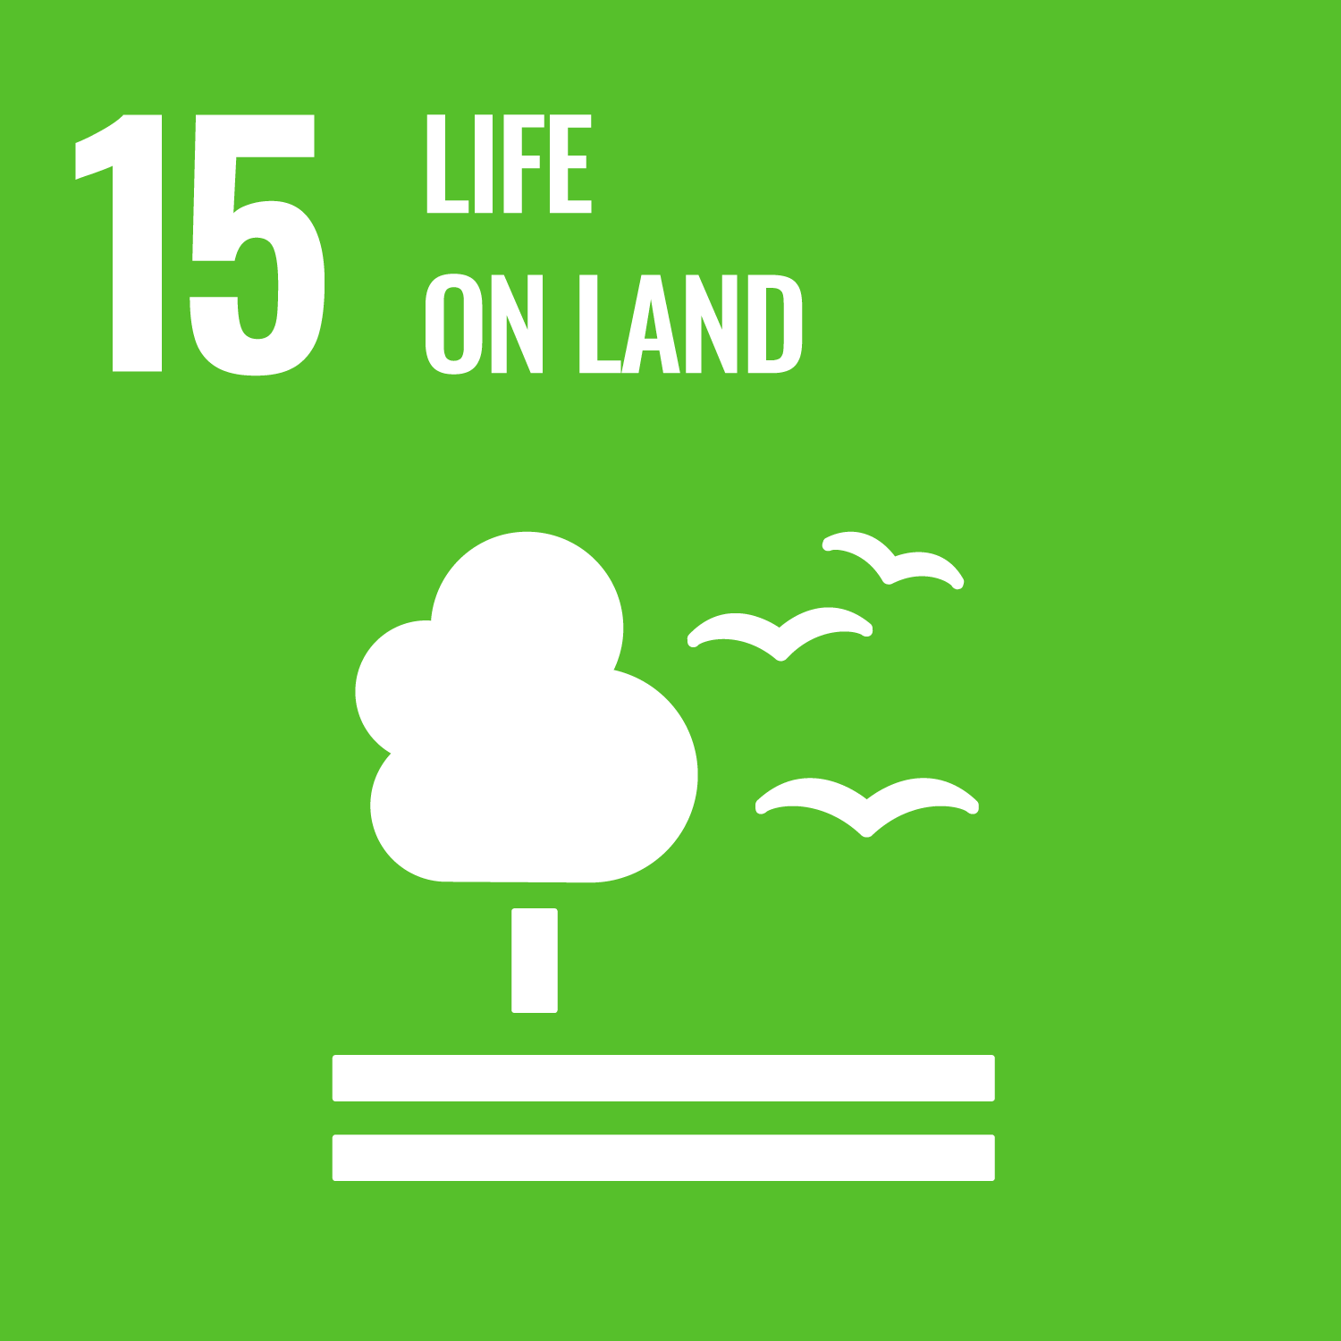
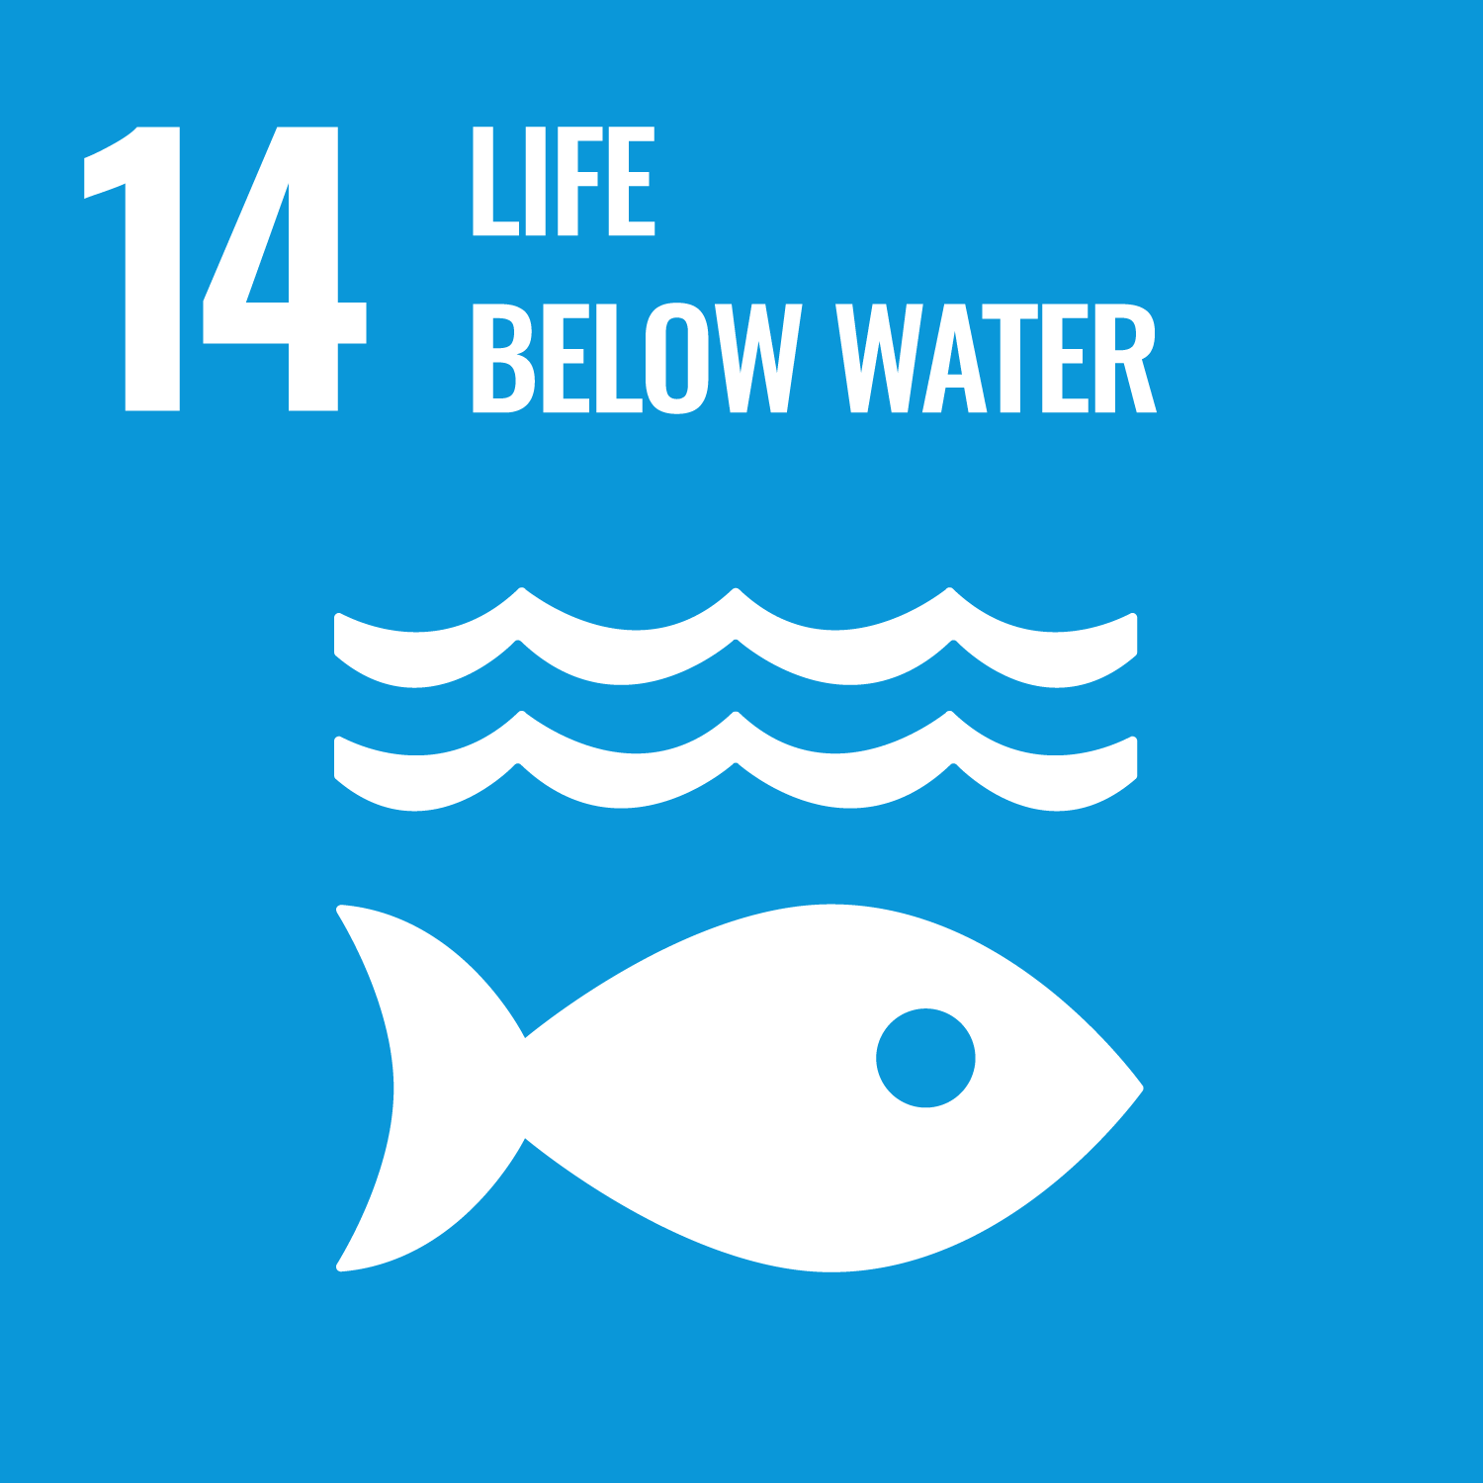
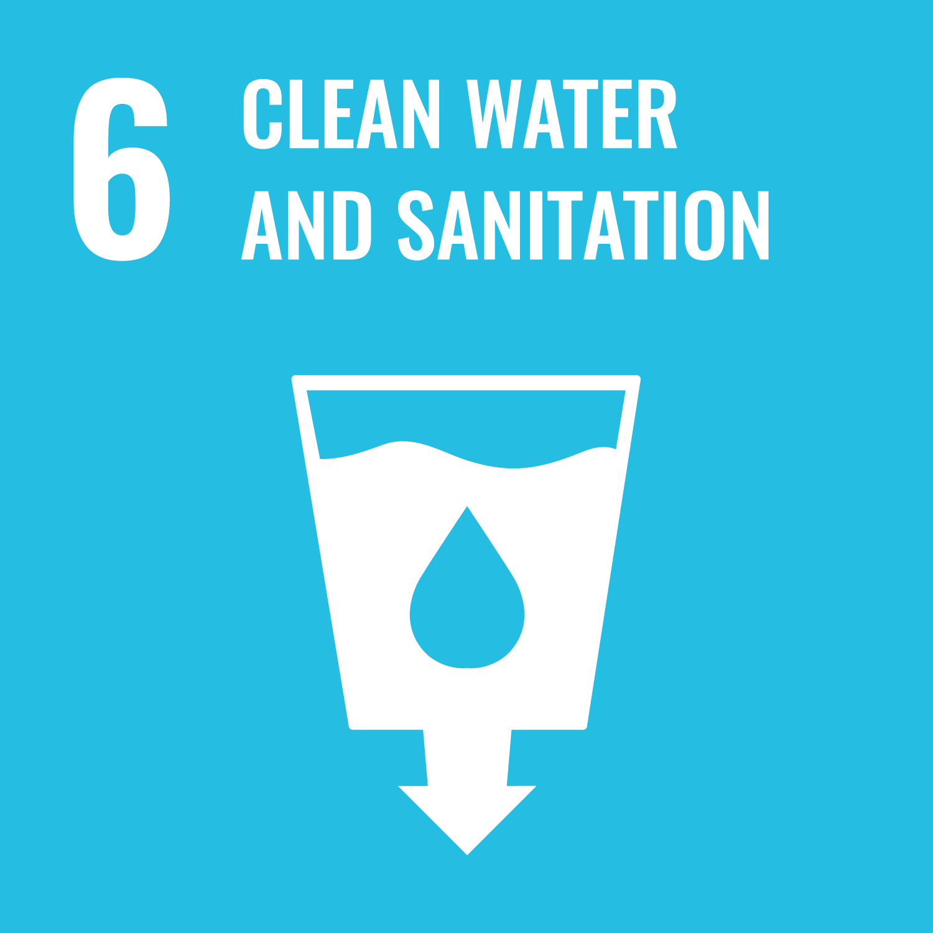
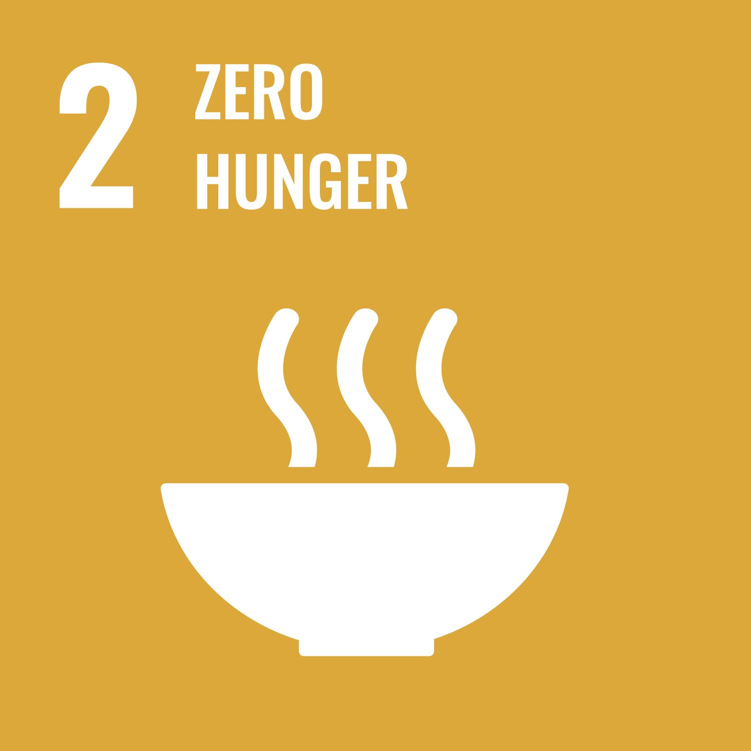
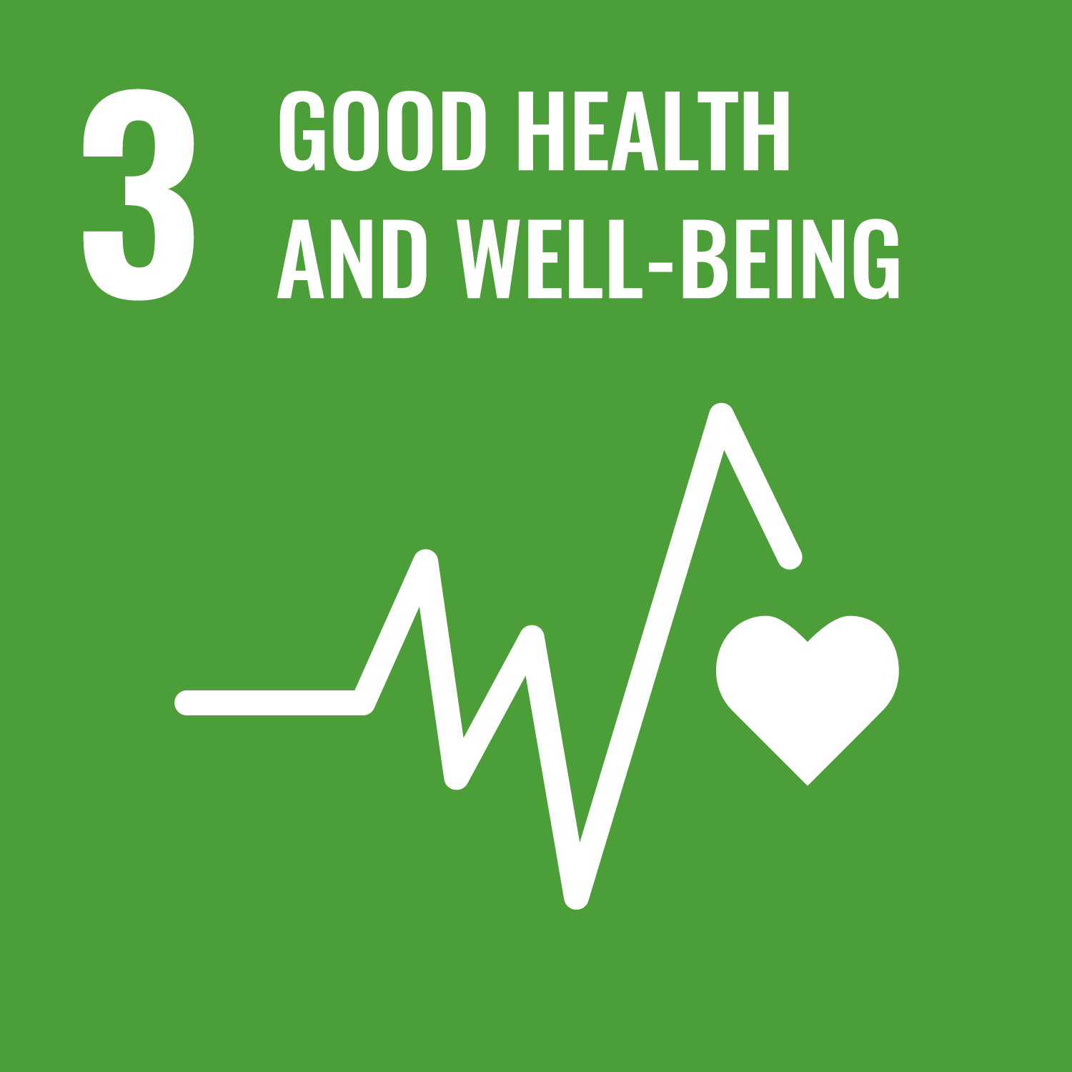
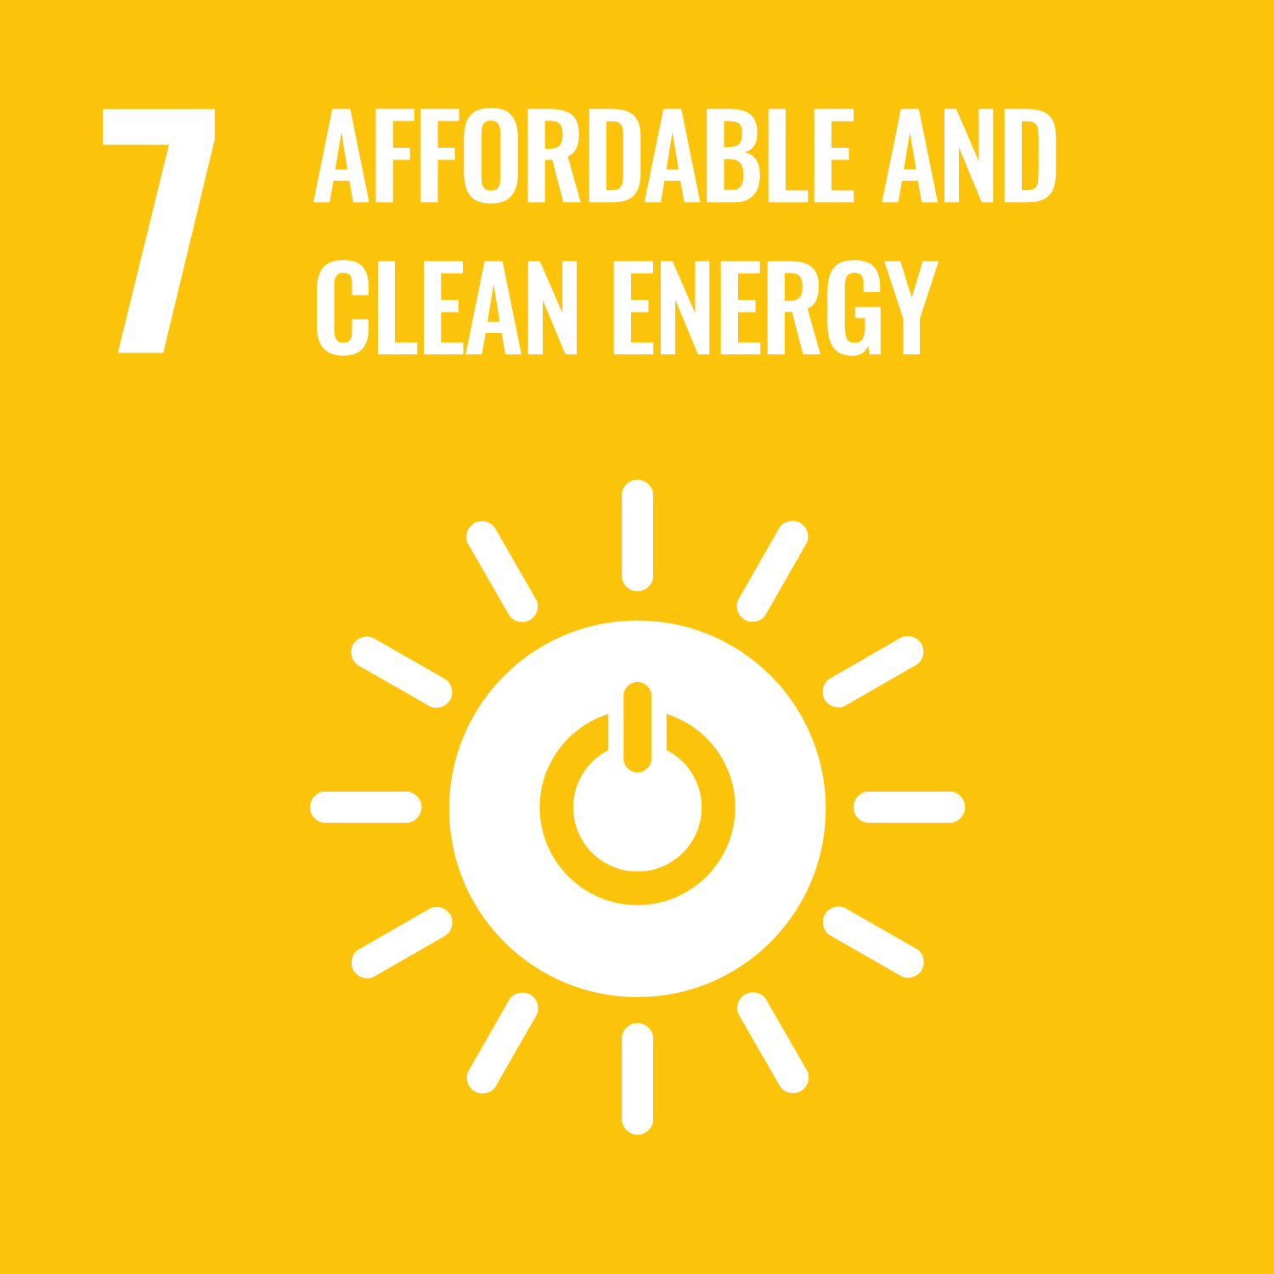

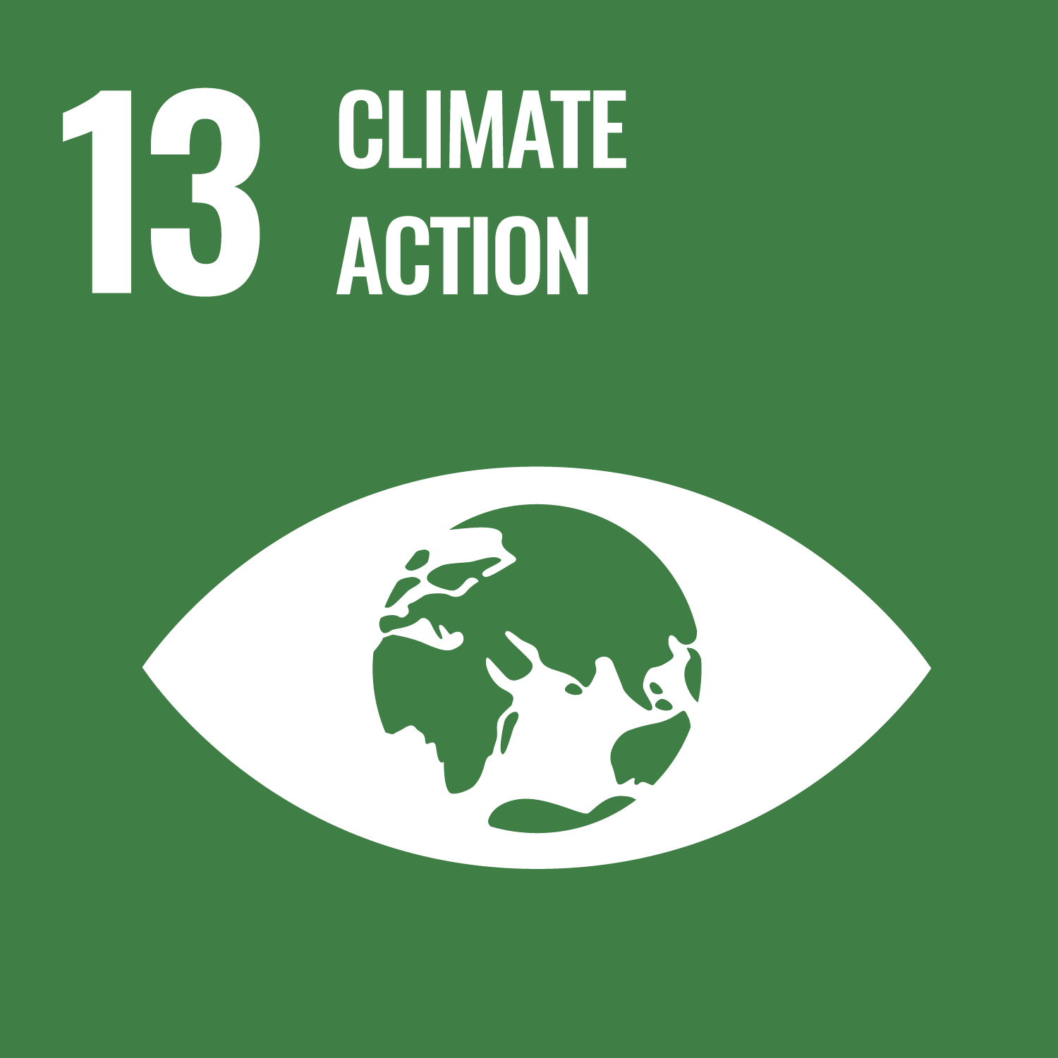


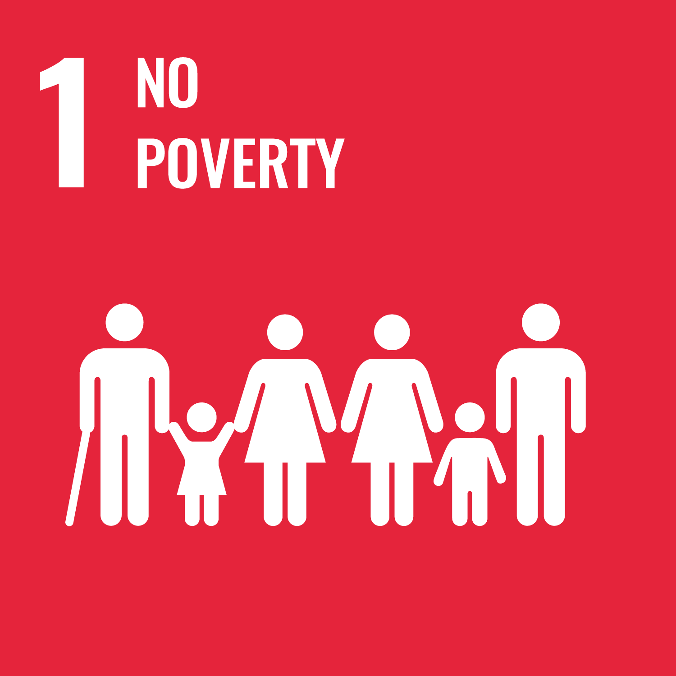

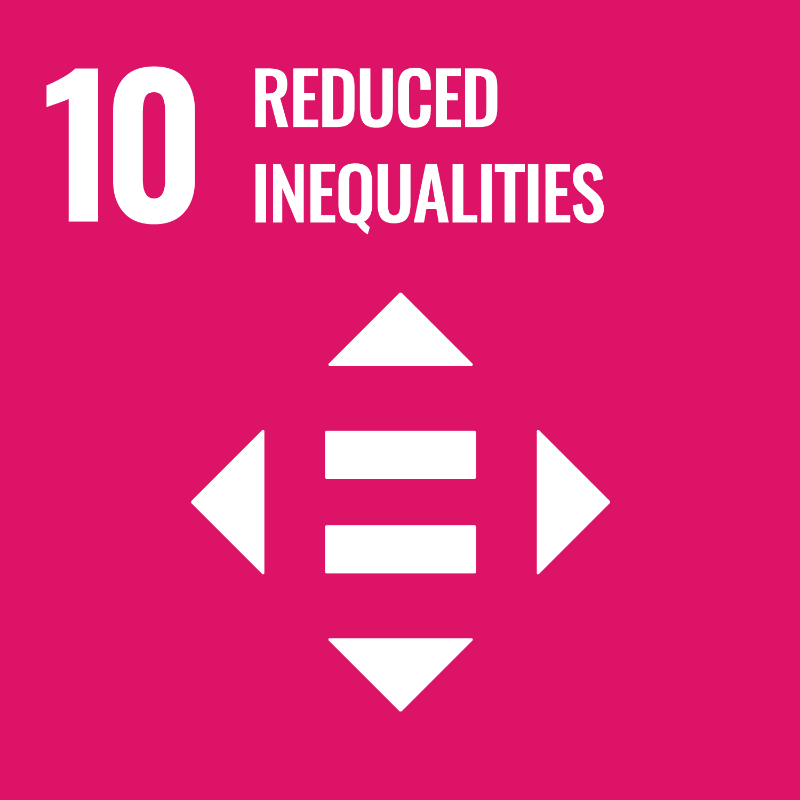
EUCRA thematic factsheets
Terrestrial & freshwater ecosystems | Marine & coastal ecosystems | Water security | Food production & food security
Human health | Energy | Built environment | EU outermost regions
EUCRA risk storylines
Extreme heat and prolonged drought | Large-scale flooding | Infectious diseases | Forest disturbances and carbon sinks
Major disruption of critical infrastructure | Disruption of international supply chains | Stability of financial markets and public finances
EUCRA synthesizing chapters
Major climate risks for Europe | Social justice and cohesion | EU adaptation policies and risk ownership | Priorities for action
Notes:
EUCRA presents its risk assessment in two formats:
EUCRA thematic factsheets: Compilation of key impacts and risks and related risks drivers for selected systems and sectors
EUCRA risk storylines: Key compound risks and risk pathways across systems and sectors that could trigger new or exacerbate pre-existing crises and emergencies with relevance for the EU
EUCRA synthesizing chapters: Synthesis of findings from the thematic factsheets and risk storylines
Most chapters have direct links to the UN Sustainable Development Goals.
While the introduction of risk storylines was intended to account for complex, systemic or emerging risks, in the end not all of them fully achieved this goal.

Slide 9
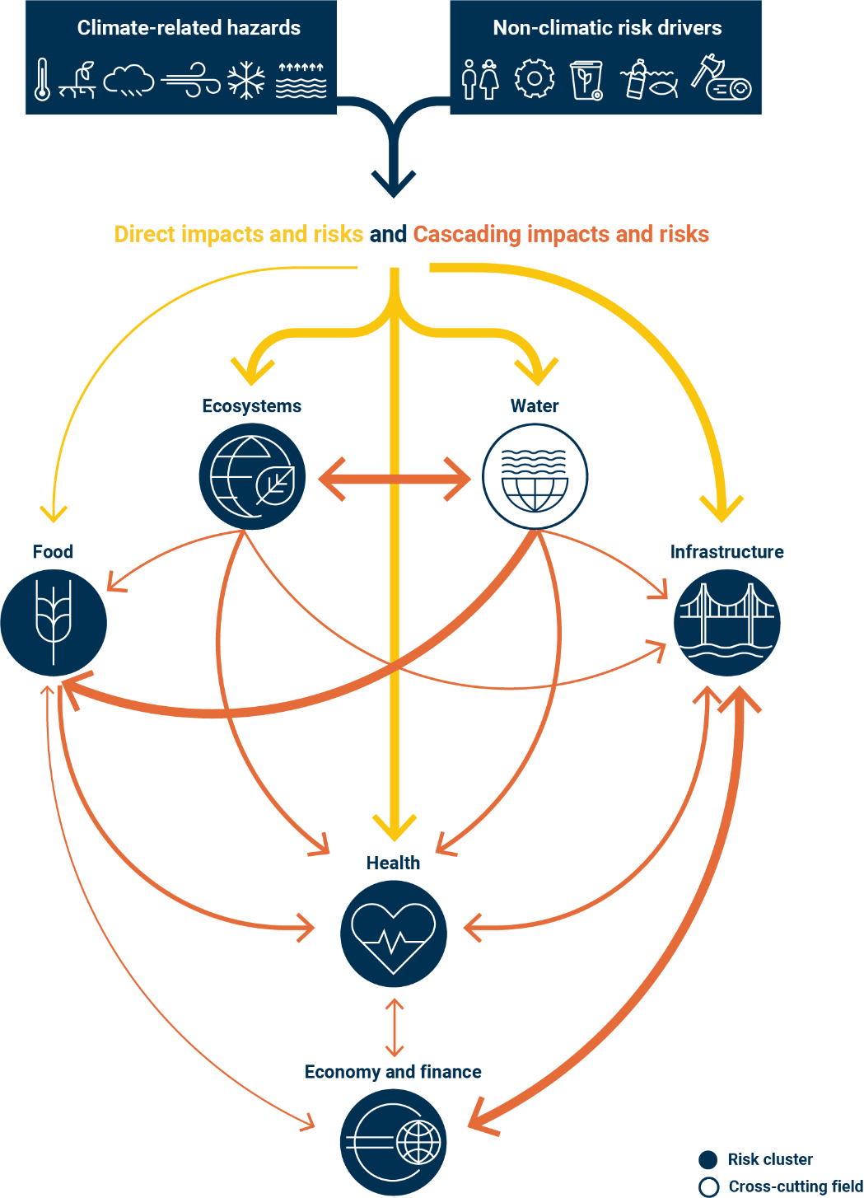
Climate risks can cascade from one system to another
Climate risks are determined by climate-related hazards (heatwaves, floods, etc.), non-climatic risk drivers (land use, etc.) as well as how prepared we are.
Climate change is a risk multiplier that can exacerbate existing risks and crises.
Cascading climate risks can lead to system-wide challenges affecting whole societies, with vulnerable social groups most affected.
For example, a mega-drought can lead to water scarcity, widespread crop losses, forest fires, poor air quality, disruptions of energy and transportation infrastructure, and threats to financial markets and stability.
Notes:
The five risk clusters are interconnected.
READ

Slide 10
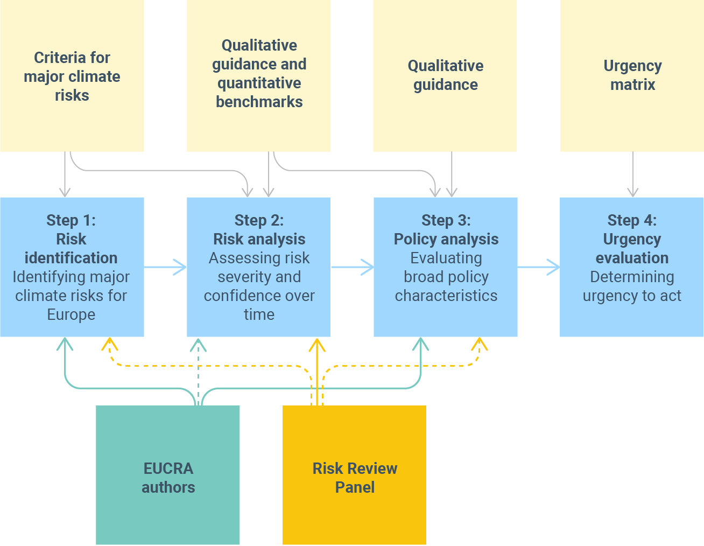
EUCRA: Structured risk evaluation
Notes:
The structured risk evaluation in EUCRA has the following objectives:
Support the identification of priorities for EU policy action;
Improve the comparability of the risk evaluation across storylines and factsheets;
Ensure the legitimacy of the risk evaluation through independent review.

Slide 11
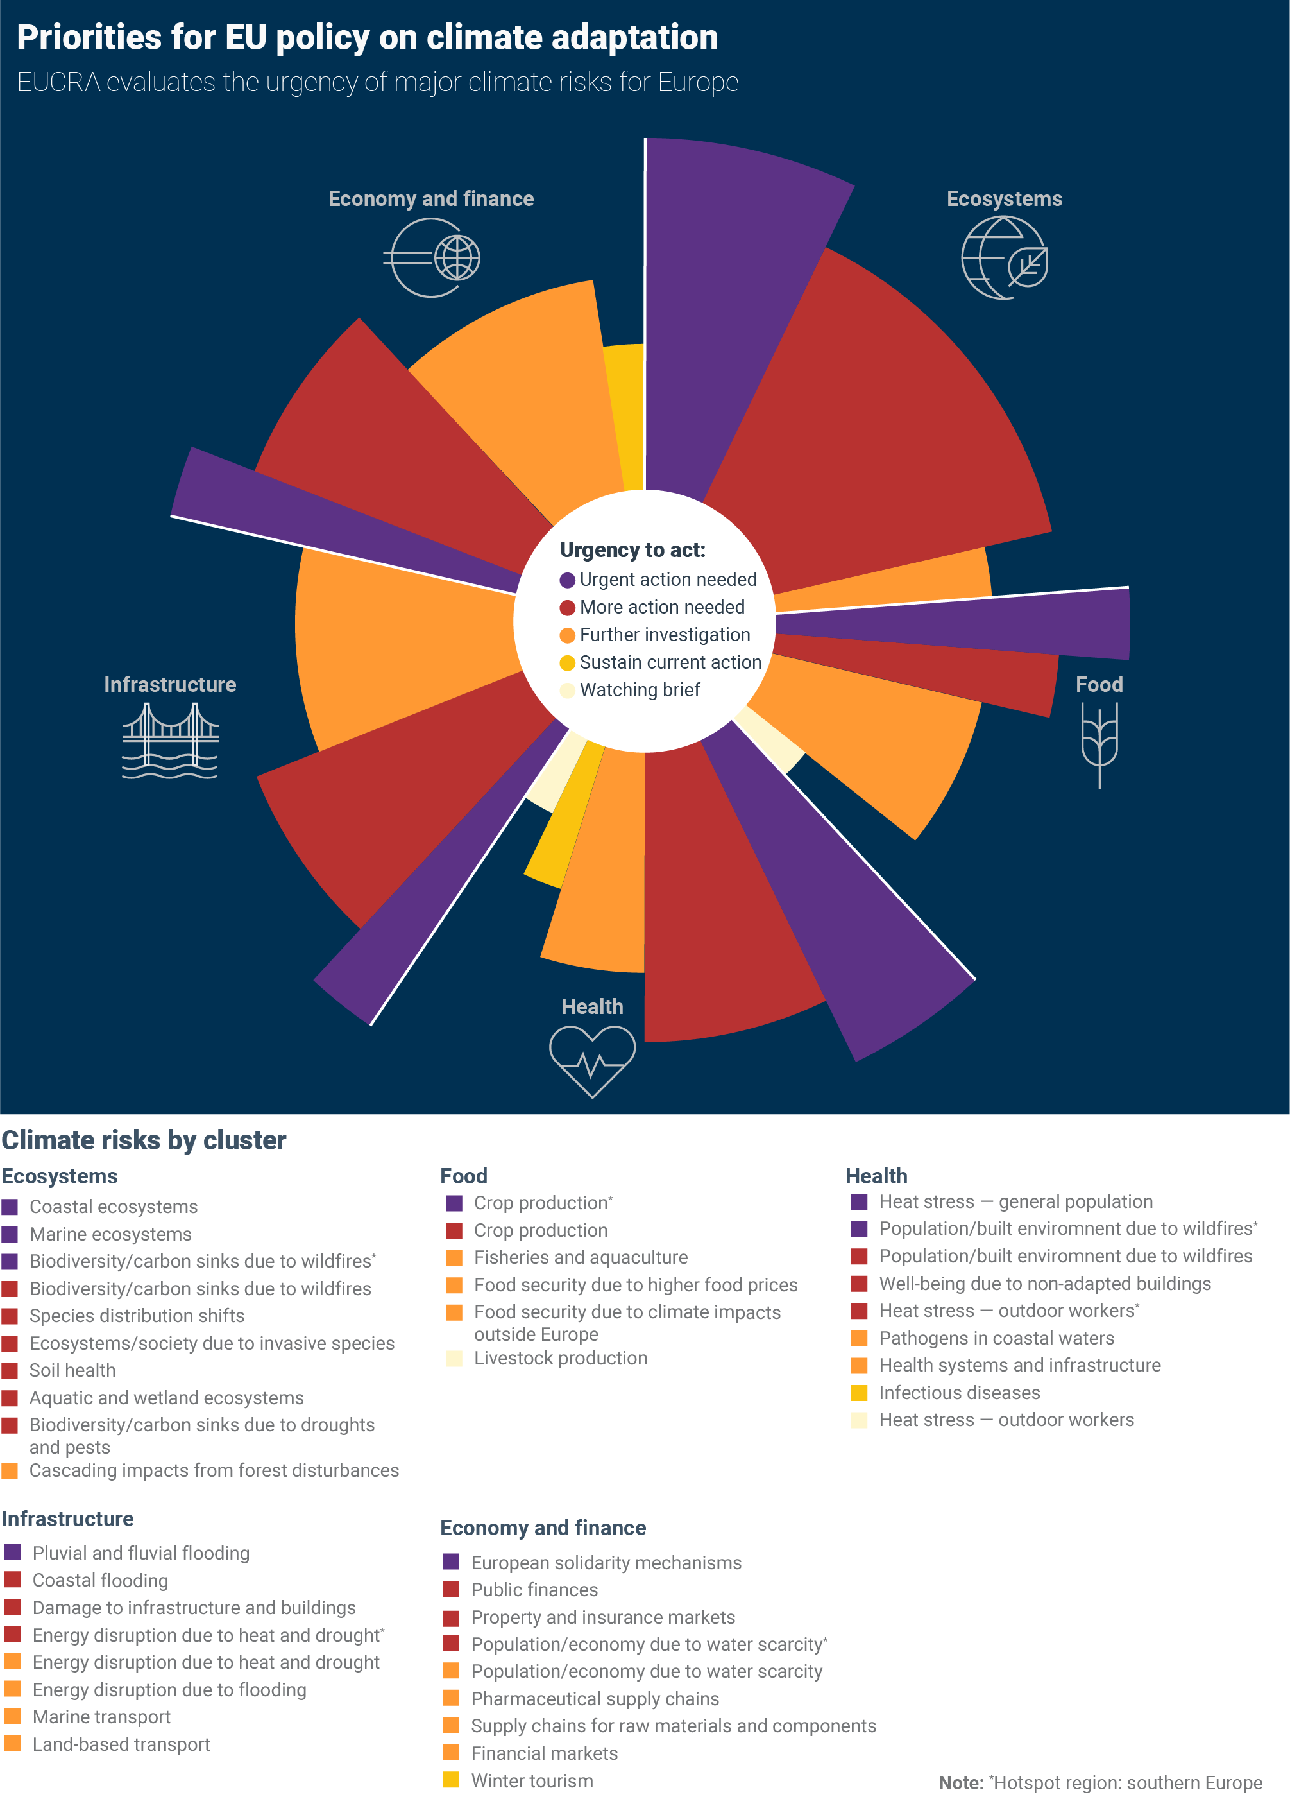
Urgent action is needed in all five risk clusters
Notes:
The systematic risk assessment process has identified and assessed 36 major climate risks for Europe, grouped into five broad clusters: ecosystems, food, health, infrastructure, and economy and finance.
Depending on their nature, each of these risks alone has the potential to cause significant environmental degradation, economic damage, social emergencies and political turbulences; their combined effects are even more impactful.
Almost all the selected major risks can reach critical or even catastrophic levels during this century, in particular under a high warming scenario.
More than half (21 out of the 36) major climate risks for Europe identified in this report need more action now, with eight of them being particularly urgent.
Urgent action is needed for risks from all policy clusters, indicating that policies need to increase in ambition, scope and implementation.
A third of these risks need further investigation, including more research, better monitoring or a review of the policy framework.

Slide 12
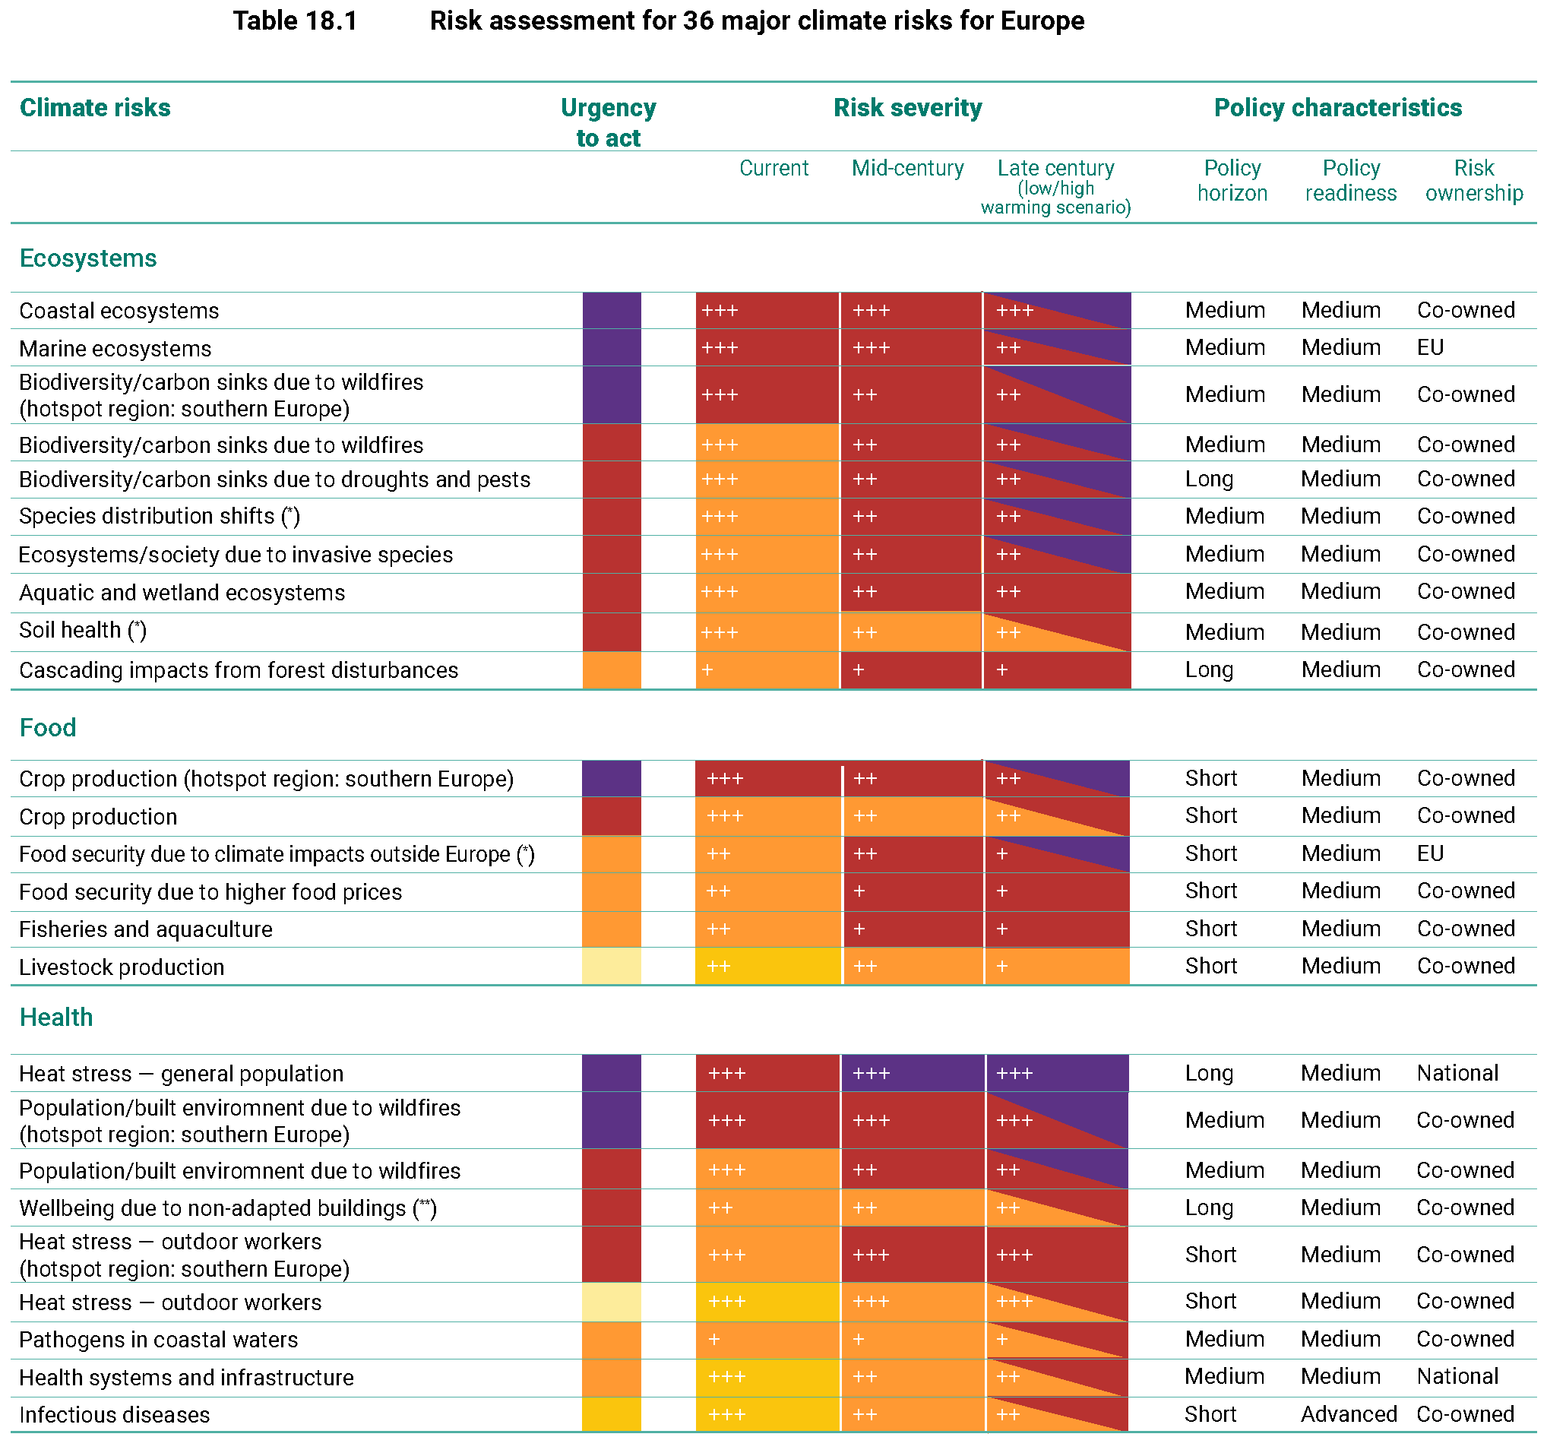
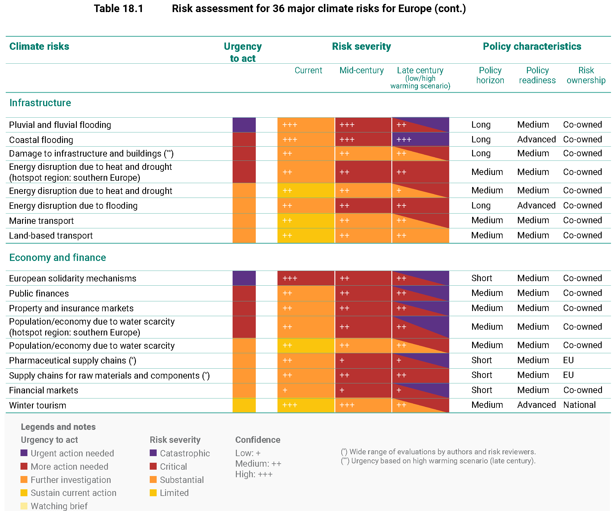
Key findings of EUCRA’s structured risk assessment
Notes:
The urgency to act for each climate risk is determined based on risk characteristics as well as the policy context, considering explicitly the time dimension
The largest number of urgent risks are in the ecosystems and health clusters
However, all clusters include risks that require urgent action now.

Slide 13
Climate change impact chain for the energy system
Notes:
The risk assessment on the previous slide with two major climate risks for the energy sector is based on a more complex assessment of pathways along which climate change can impact various elements of the energy system, that is:
Production and generation
Transport, transmission and distribution
Demand
The aggregation of information from many impact pathways to two major climate risks (in red) reflects the need to keep the total number of major risks in EUCRA manageable

Slide 14

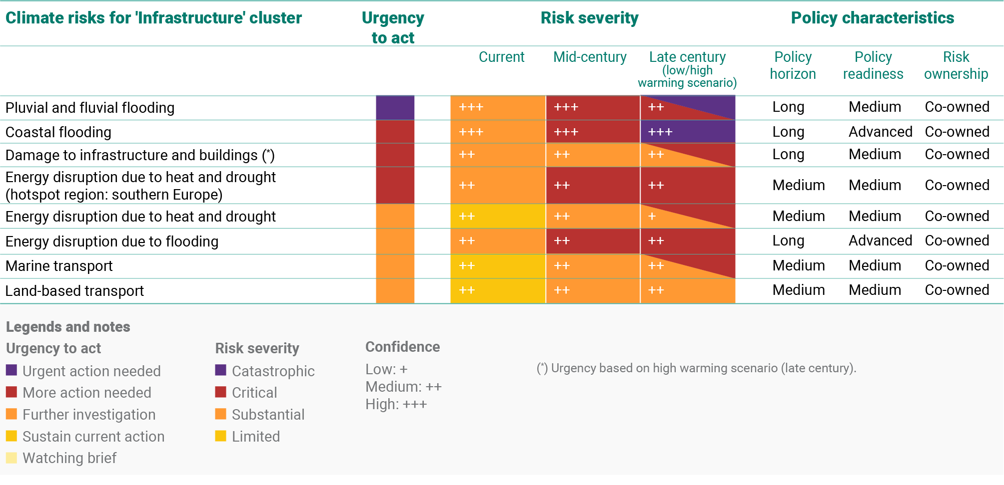
Notes:
Risks to the energy system are covered primarily in the Infrastructure cluster
Extreme weather events are posing increasing risks to the built environment and infrastructure in Europe, as well as the services they provide.
Such events can disrupt essential services, including energy supply, water supply and transport networks.
Pluvial and fluvial flooding are already creating substantial risks for the built environment and population across Europe, as evidenced by various highly destructive floods in recent years.
Coastal flood risks have been successfully managed in Europe overall, no substantial losses in the last 50 years, but the accelerating pace of sea-level rise and the exponential increase in flooding risks resulting require more action now.
The European energy system is exposed to multiple climate risks, with southern Europe affected most strongly.
Combined heat and drought, and coastal and inland flooding, are identified as major risks for the energy system, but storms, wildfires, and gradual temperature changes are relevant as well.
ANIMATION
Key priorities for policy action include conducting assessments and implementing measures to enhance the resilience of critical infrastructure on a systems level, and incorporating climate projections into the Eurocodes.
Increasing resilience to climate change needs to be an essential part of EU climate and energy policies.
Ensuring security of supply in southern Europe during prolonged droughts and heat waves is key.

Slide 15
Energy security: major climate risks and risk pathways
Climate change intensifies risks to European energy systems through
increased cooling demand,
regional reductions in hydropower potential,
reduced efficiency of thermal power plants and electricity transmission, and
impacts of extreme weather events on energy infrastructure (coastal and inland floods, storms, and wildfires).
Southern Europe faces the largest risks to its energy security. Prolonged droughts affecting electricity supply in combination with heatwaves affecting peak electricity demand can lead to power cuts.
A stable and affordable energy supply is central for a modern society. Risks to energy supply can cascade to all societal sectors and activities, threatening security, economic well-being, and human health.
The role of electricity is increasing in a decarbonized energy system.
Notes:
READ

Slide 16
Energy security: EU policy priorities
The transformation of the European energy system must integrate mitigation and adaptation considerations. European and national decarbonisation strategies must consider climate change during the long lifetime of energy infrastructure.
The updated NECPs 2021-2030 provide a near-term opportunity for doing so.
Enhancing energy system resilience requires detailed risk assessments, infrastructure maintenance, and technological innovations. Improving energy efficiency and demand-side management can further increase energy security.
National implementation of the Regulation on Risk-preparedness in the Electricity Sector and the Critical Entities Resilience Directive needs to ensure comprehensive consideration of current and future climate risks.
Social justice considerations are essential in energy adaptation planning, ensuring equitable access to resources and addressing energy poverty.
Notes:
READ

Slide 17
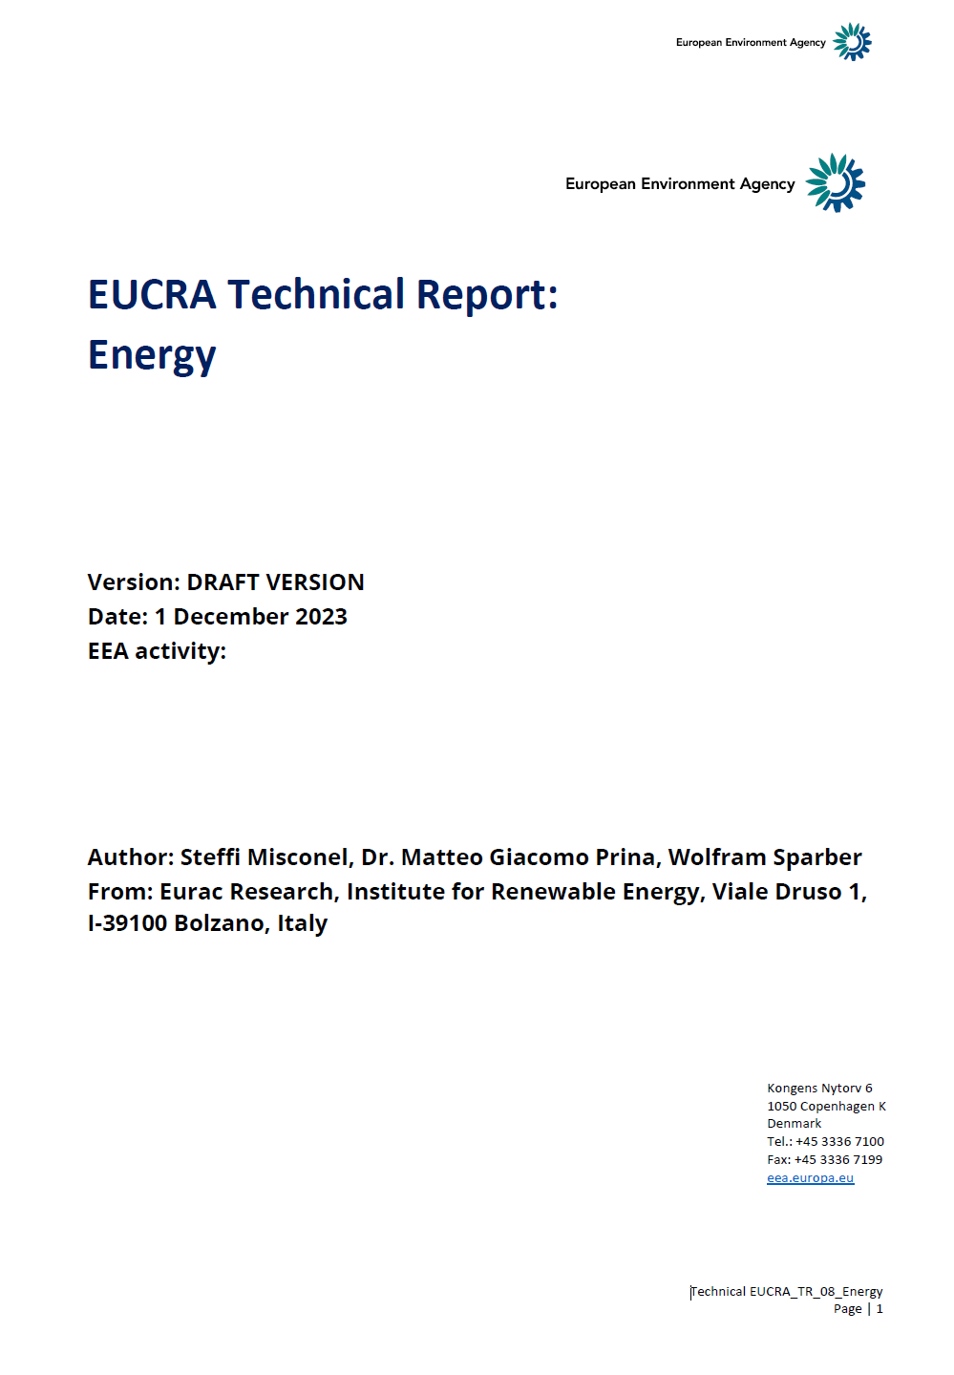
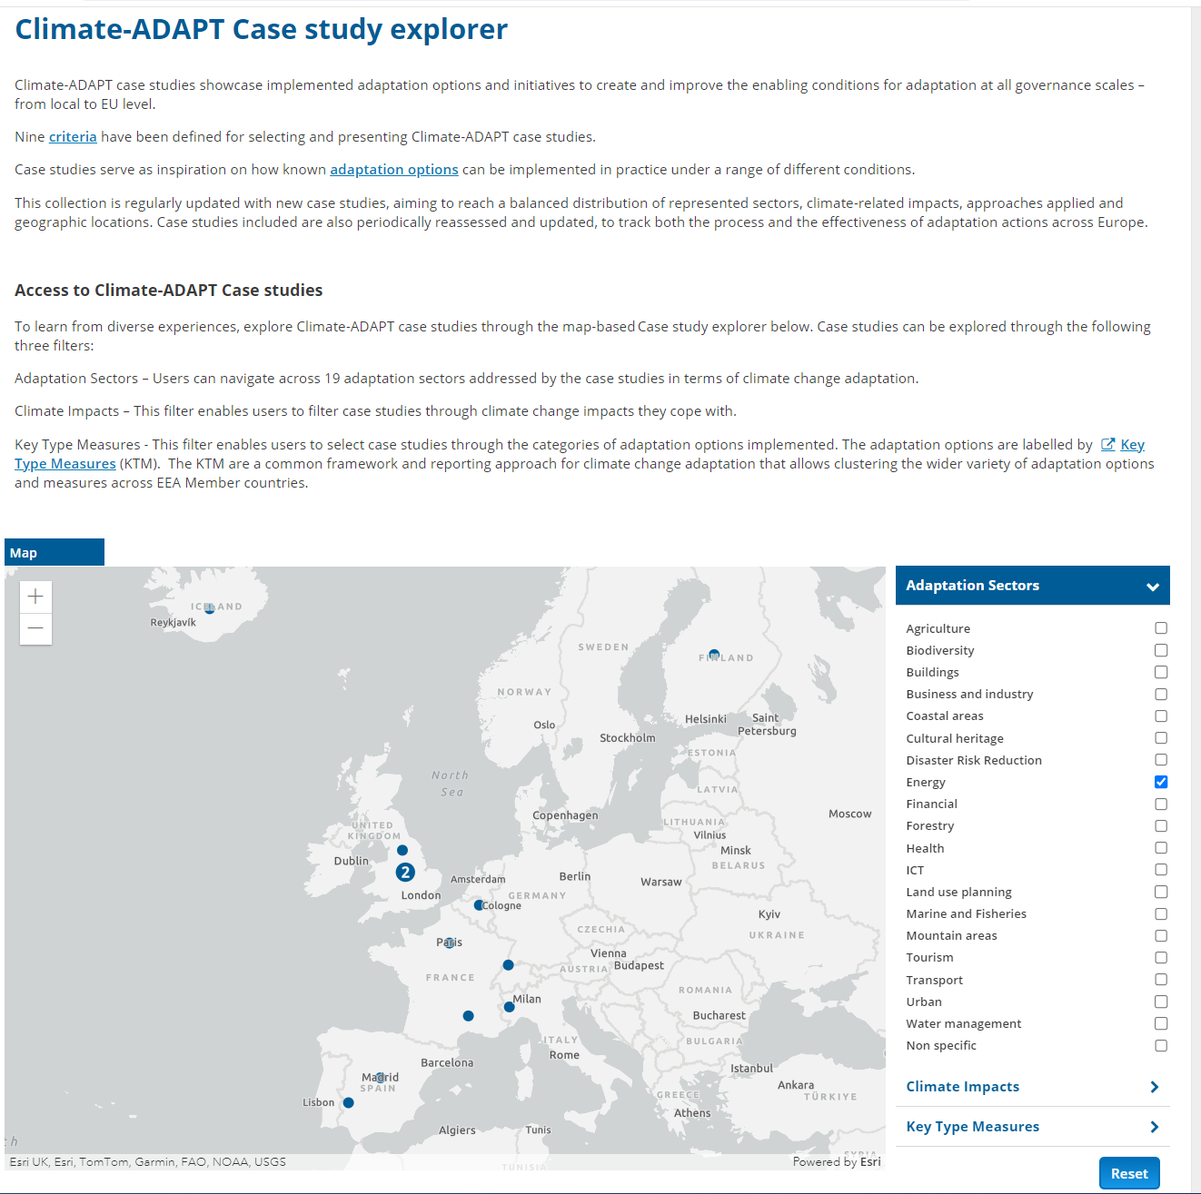
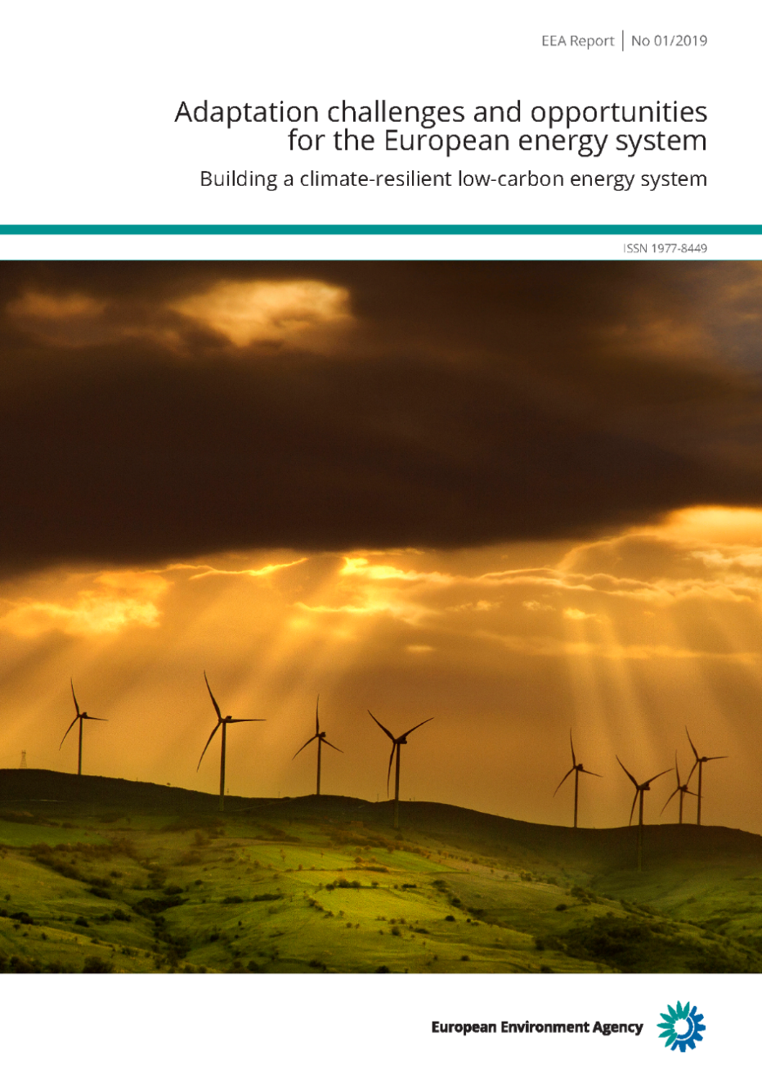
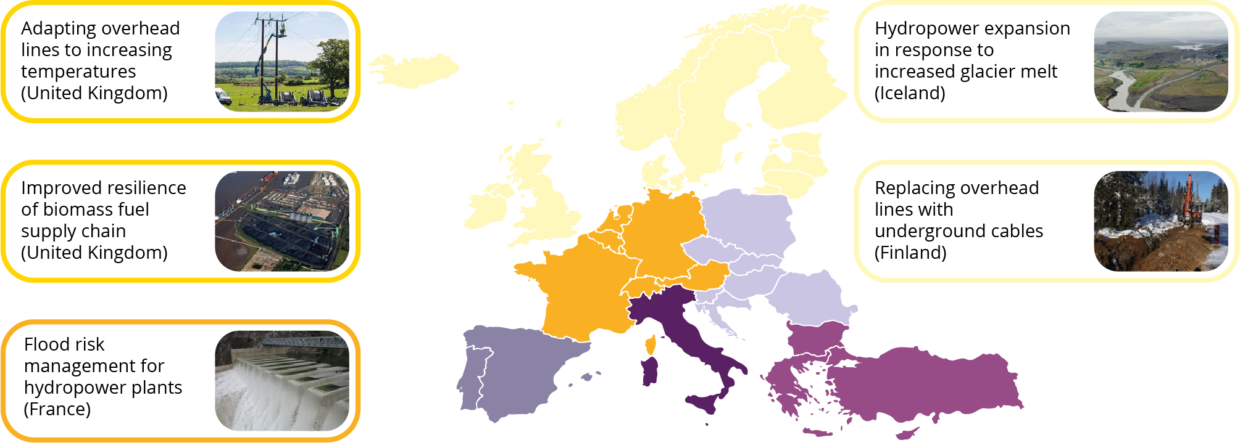
Further EEA resources on climate adaptation and energy
climate-adapt.eea.europa.eu/en/ knowledge/tools/case-study-explorer
eea.europa.eu/publications/ adaptation-in-energy-system
Draft (available on request)
Notes:
The EEA provides further relevant information on the transformation of the European energy system:
A EUCRA technical report (currently available as draft only)
The European Climate Adaptation Portal, Climate-ADAPT
A report about adaptation challenges and opportunities for the European energy system (from 2019; one of the last ones that was printed)

Slide 18
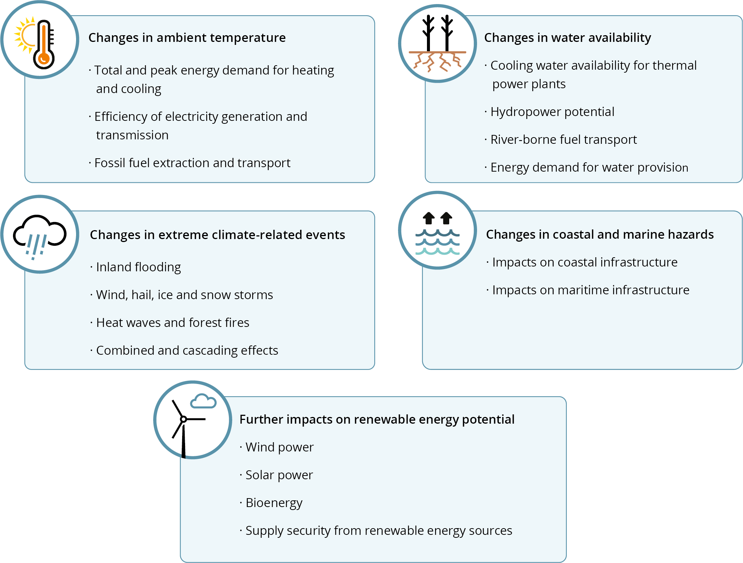
Key climate risk drivers for the energy system
Notes:
The 2019 EEA report provides more detailed information about climate impacts and adaptation needs and opportunities for the European energy system.
The policy context has evolved whereas the scientific assessment is still essentially valid.
All components of the energy system are vulnerable to climate change and/or extreme weather events.
Climate change impacts – and related adaptation needs - differ across regions and energy sector components.
Climate change is projected to have adverse as well as beneficial impacts on the energy system in northern Europe. In contrast, impacts are overwhelmingly adverse in southern Europe.
The development of clean energy strategies needs to address these impacts:
For example, hydropower strategies in southern Europe need to consider the risk of decreasing water avaiability.
Similarly, expansion strategies for electricity grids should assess whether current design standards are still sufficient in a world with more extreme heatwaves and, potentially, stronger storms.

Slide 19
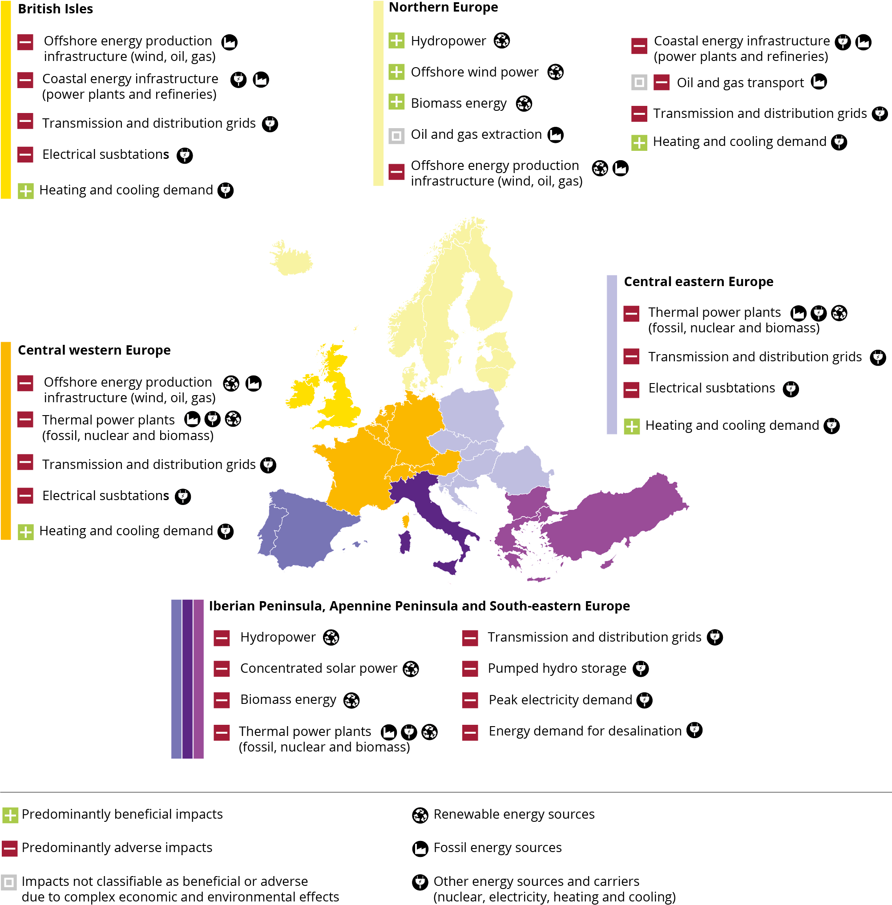
Climate change impacts on the energy system by region
All components of the energy system are vulnerable to climate change and/or extreme weather events
Impacts differ across regions and energy sector components
Southern European regions are most adversely affected
Notes:
In particular, the 2019 EEA report provides more regional detail regarding climate impacts and adaptation needs for the European energy system.

Slide 20
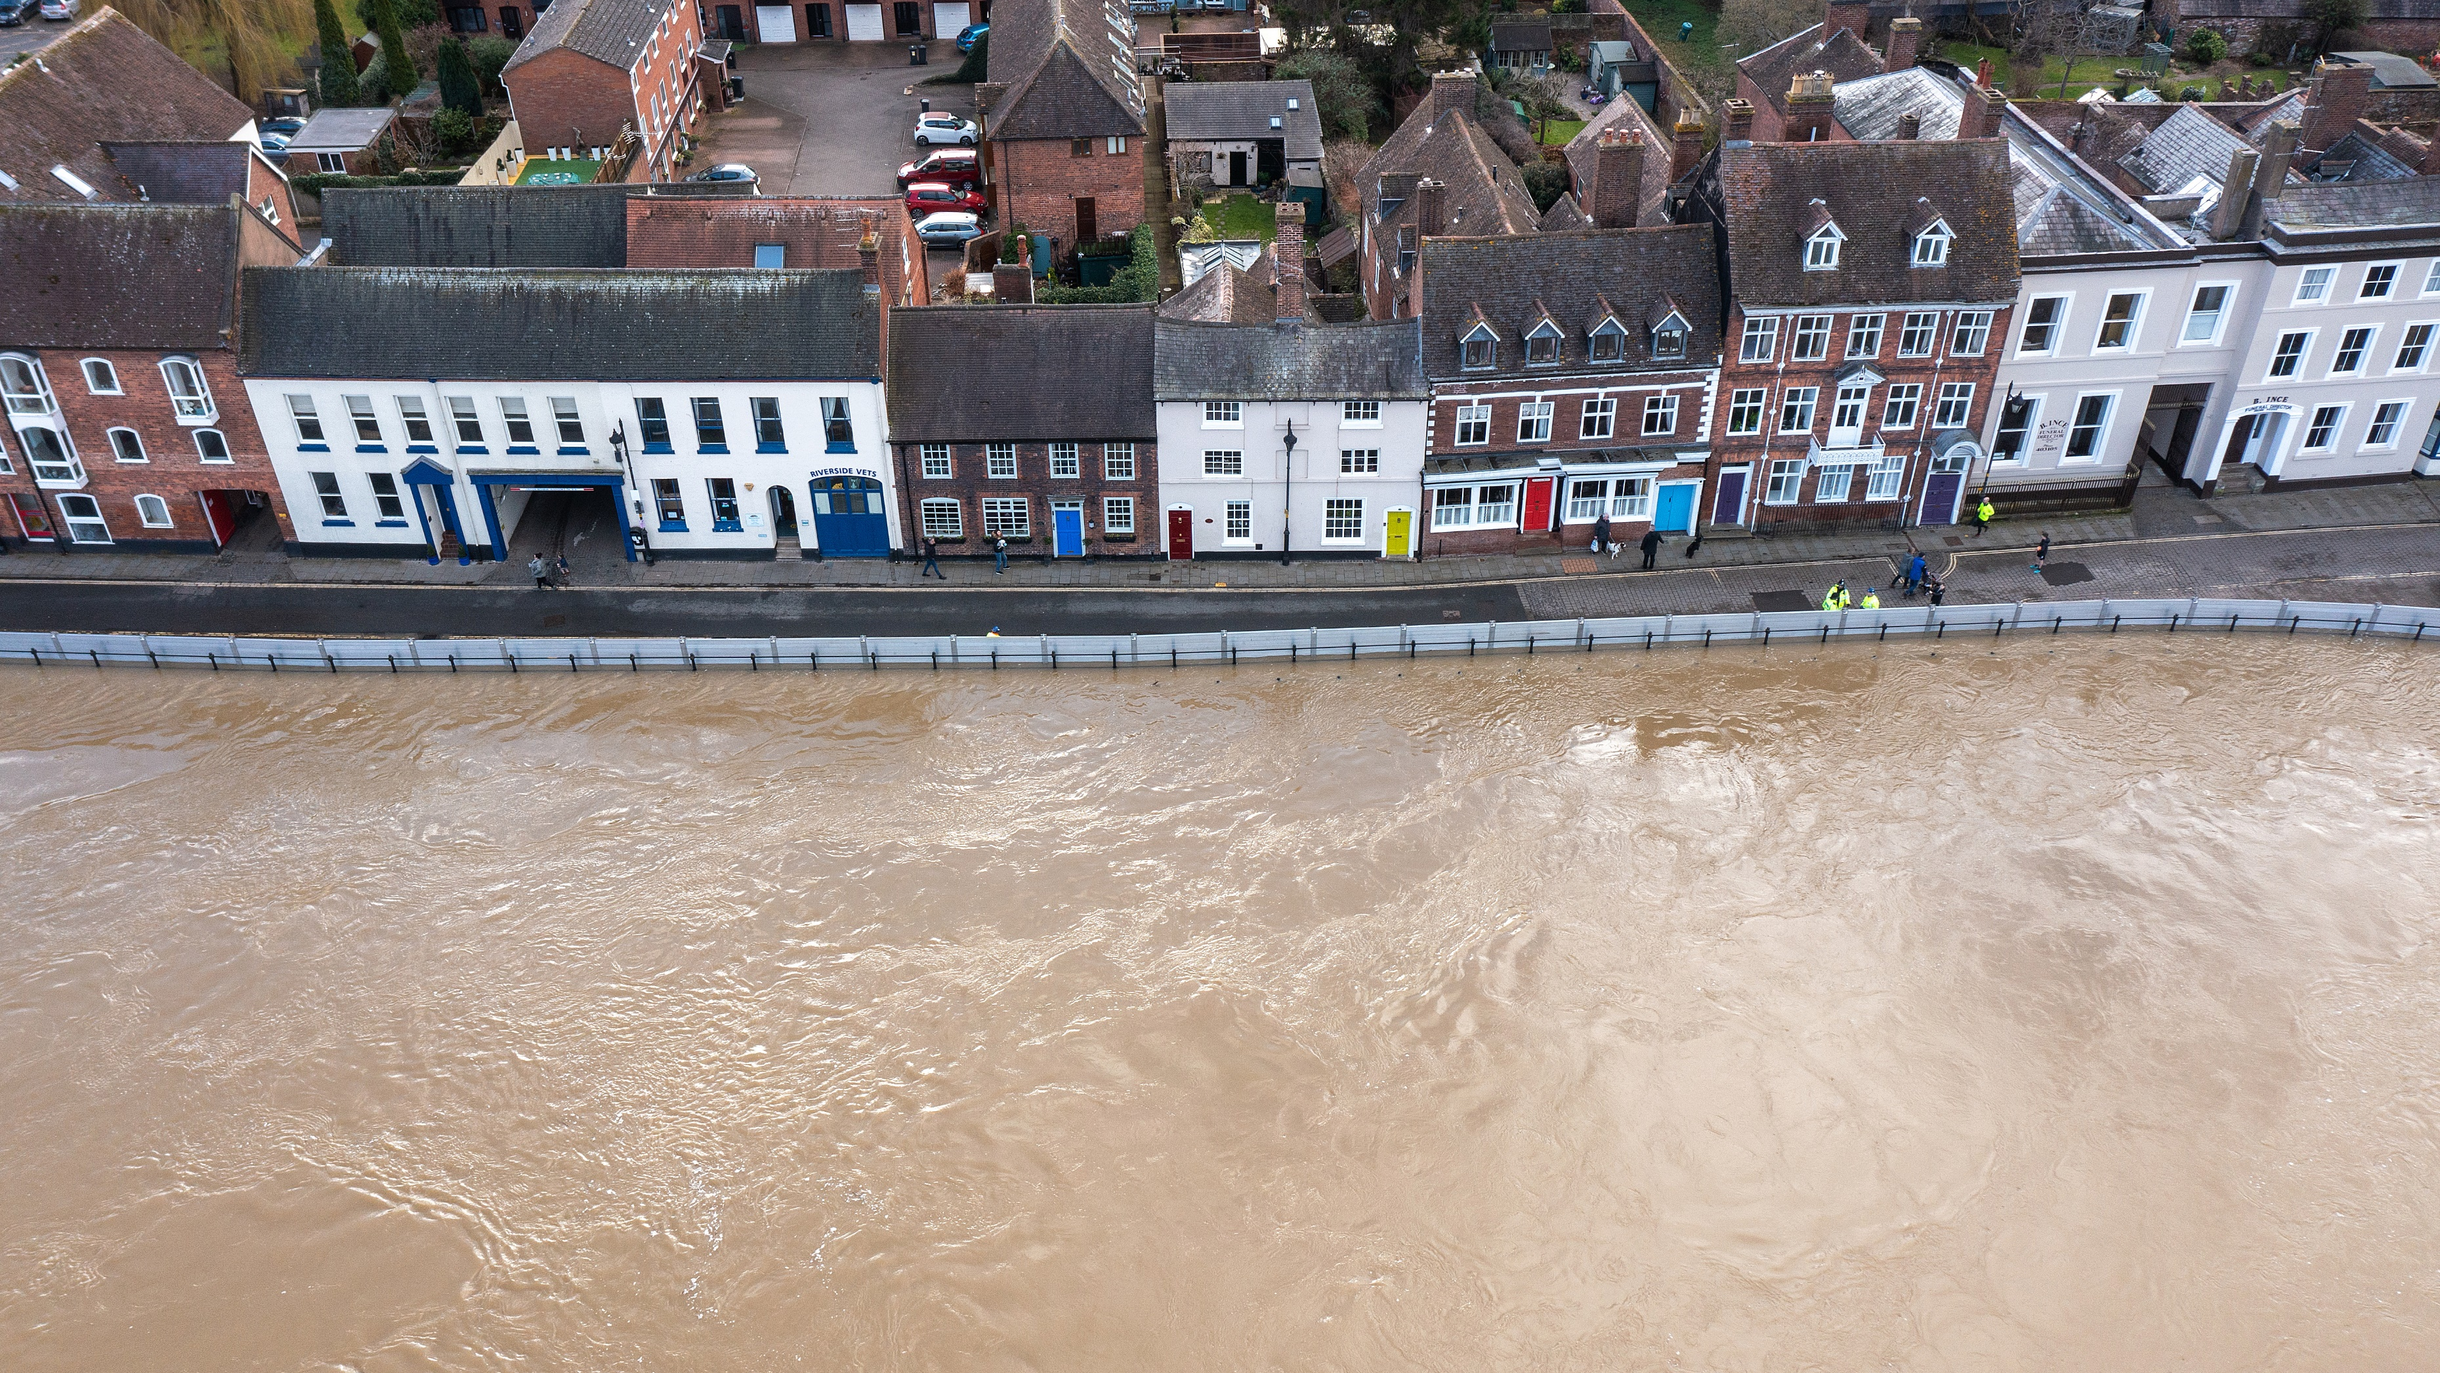
Дякую
For more information:
climate-adapt.eea.europa.eu/en/eucra
Contact us:
EUCRA@eea.europa.eu
©Christopher Furlong via Getty Images

